Slide 1
  Chapter 14
  Ecommerce, Databases, and Data Science

Slide 2
Learning Objectives (1 of 2)
Explain the issues, pros, and cons of whether to create an ecommerce website.
List the components of online transactions, and explain what is involved in each step.
List one other ecommerce model besides the online retailer selling to the general public and explain how it works.
List one other electronic payment system besides traditional credit cards and explain how it works.

Slide 3
Learning Objectives (2 of 2)
Describe the relational database model
Frame simple queries in SQL to retrieve information from one or more tables in a relational database
Define data mining
List three sources data brokers use to collect data on individuals
Give an example of data science used "for the greater good"

Slide 4
Introduction
The World Wide Web enables businesses to communicate with customers through:
  Advertising
  Follow-up support
  Sales to consumers
  Sales to other businesses
  Non-sales transactions (statements and bill pay)

Slide 5
Ecommerce (1 of 16)
Ecommerce: business conducted with the Internet and via the web including sales, advertising, and bill pay options
Setting up an organization for ecommerce can be as intensive as setting up a physical store front.
What business problem are you solving?
  Broadening the customer base
  Recapturing customers lost to online competitors
  Serving existing customers better
  Integrating departments of existing business

Slide 6
Ecommerce (2 of 16)
Risks of moving online
  Same customers moving from in-store to online
  Facing new competition online
  Existing customers don’t need/want online store
  Employee concerns
Costs of moving online
  Computer equipment and infrastructure
  Hiring personnel to manage the website
  Legal expertise required to protect your intellectual property, regulations online, and customer privacy

Slide 7
Ecommerce (3 of 16)
Ecommerce decisions:
  Design website in-house or hire an ASP (Application Service Provider)
  Buy or lease equipment
  Use existing software or have custom software written

Slide 8
Ecommerce (4 of 16)
Customer transaction overview
  Customer learns of your site and goes there
  Identify return customers and personalize the site
  Provide a secure environment for making purchase
  Process the payment
  Communicate with accounting and credit company
Order fulfillment
  Update inventory
  Contact shipping system and shipping company
  Arrange pick up and delivery to customer

Slide 9
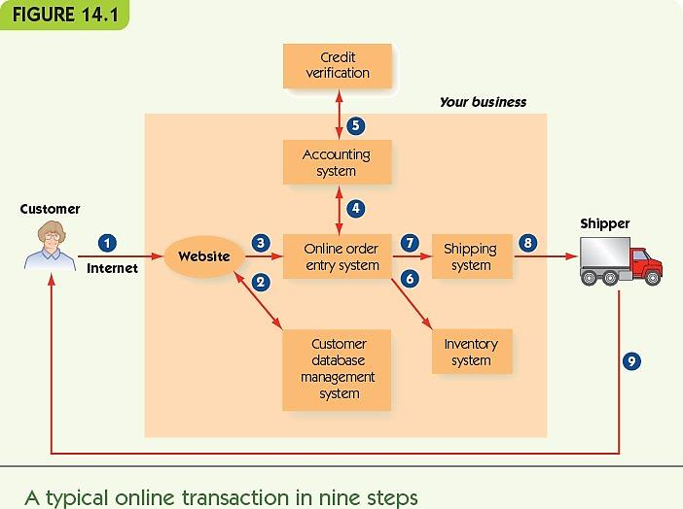
Ecommerce (5 of 16)

Slide 10
Ecommerce (6 of 16)
How do customers learn about your site?
  Conventional print advertising with URL
  An obvious domain name (home page URL)
    ICANN (Internet Corporation for Assigned Names and Numbers) registers domain names
  Search engine results (sponsored link)
  Presence on a portal (website about a topic) with links to retail, wholesale, and informational websites

Slide 11
Ecommerce (7 of 16)
Identify return customers and personalize the site
  Require the user to register and log in
    Connects to the database with the user’s past history on the site
  Leave a cookie on the user’s computer
    Small text file containing information about the user
    Allows continuity between one page of a site and another
    (Relatively) harmless

Slide 12
Ecommerce (8 of 16)
Provide a secure environment for making a purchase
  Encryption: ensure sensitive information is encrypted for transmission
  Authentication: verify that your website is legitimate

Slide 13
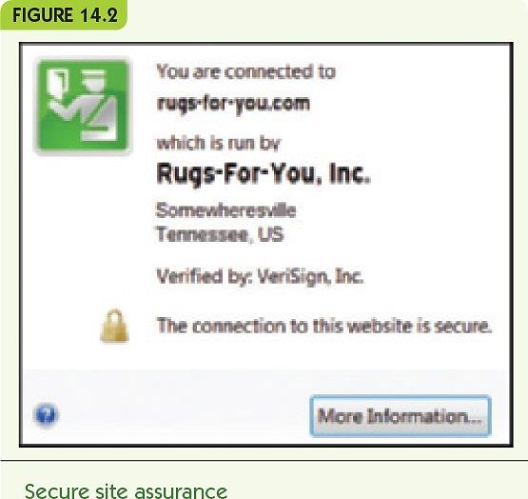
Ecommerce (9 of 16)

Slide 14
Ecommerce (10 of 16)
Process payment
  Option 1: while the customer waits
    Online form communicates with accounting software
    Accounting system verifies customer credit
    Customer can correct bad information
    No need to keep credit card numbers
  Option 2
    Record the order and payment information
    Verify and complete the transaction offline
    Send email confirmation to the customer

Slide 15
Ecommerce (11 of 16)
Fulfill the order
  Communicate with online inventory
    Reduce item counts for purchased items
  Arrange for shipping
    Online shipping system
    External shipping company
  Arrange pick-up at the warehouse and delivery to the customer

Slide 16
Ecommerce (12 of 16)
Website design: overall
  Attractive with new products displayed
  Good design principles
  Organize for natural shopping habits
  Make it easy to navigate
    Provide site map or navigation bar
    No more than four clicks from one page to another
  Encourage browsing and targeted searching
  Ensure the site works on different platforms and browsers

Slide 17
Ecommerce (13 of 16)
Website design: purchase
  Provide electronic “shopping carts”
  Checkout steps that:
    Always show details of order
    Clearly indicate what the next button click does
    Allow the customer to go back and change things
    Give the customer shipping options
    Provide email with order information and shipping confirmation

Slide 18
Ecommerce (14 of 16)
Website design: other information
  FAQ page and link to customer service
  Entries allowed for customer reviews or forums
  News and press releases
  Links to your social media sites

Slide 19
Ecommerce (15 of 16)
  Multiple software systems must communicate
    Website, accounting, inventory, and shipping
    Suppliers, orders, and billing
    Personnel
  Legacy code: existing old software still in use
  Middleware: software to enable separate systems to communicate
  Disaster recovery strategy: response to natural disasters, equipment failures, or being hacked

Slide 20
Ecommerce (16 of 16)
Other ecommerce models
  eBay: peer-to-peer auction-style sales
  Craigslist: peer-to-peer classified ads
  Groupon: group coupons
    Businesses post coupons for one day only
    Minimum number required
  PayPal: online payment service
  Apple Pay and similar system: mobile payment systems
  Bitcoin: virtual currency

Slide 21
Databases (1 of 15)
Databases store large amounts of data
Businesses require databases for:
  Inventory, personnel, customers, suppliers, and financials
Data organization
  Bits and bytes: basic pieces of computer data
  Field: one meaningful piece of information
  Record: a set of related fields
  Data file: a set of related records
  Database: a set of related data files

Slide 22
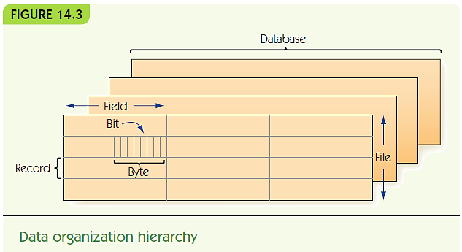
Databases (2 of 15)

Slide 23
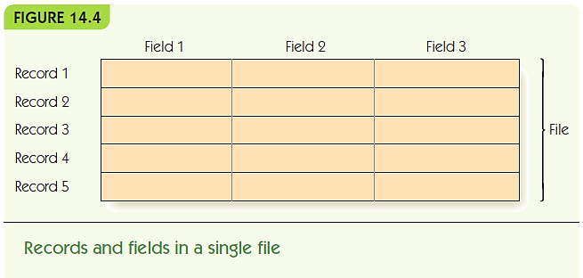
Databases (3 of 15)
Data files are represented as tables
  Records are rows; fields are columns

Slide 24
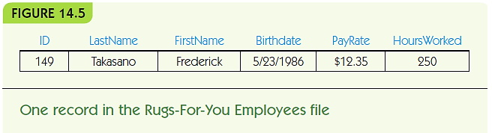
Databases (4 of 15)
Rugs-for-You: example of an employee record
  Record = one employee
  Each field has:
    A field name (a category) with a specific data type
    A value in the field for the selected record (employee)

Slide 25
Databases (5 of 15)
Database management system (DBMS)
  Manages files in a database
Relational database model: files are 2-d tables
  Entity: a distinguishable component of system
    Example: an employee, a customer, or a rug for sale
  Tuple: a row of a relational table
  Attribute: category of a field
  Primary key: attribute(s) that uniquely identify a tuple

Slide 26
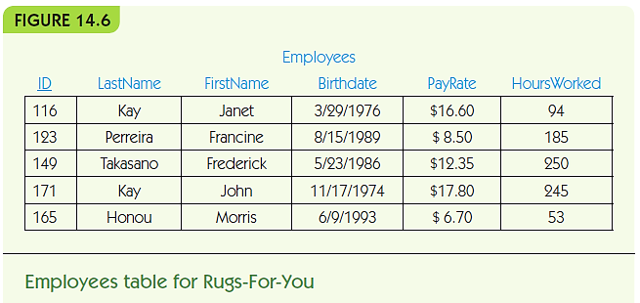
Databases (6 of 15)

Slide 27
Databases (7 of 15)
SQL (Structured Query Language)
  Standard query language for DBMS
  Use SQL queries to retrieve data according to some criteria
  Example 1: retrieve employee name, pay rate, and hours worked for employees named Perreira

Slide 28
Databases (8 of 15)
SELECT ID, LastName, FirstName, Payrate, HoursWorked
FROM Employees
WHERE LastName = ‘Perreira’;
SELECT *
FROM Employees
ORDER BY ID;
SELECT *
FROM Employees
WHERE PayRate > 15.00

Slide 29
Databases (9 of 15)
  Example 2: retrieve all employee records, sorted by ID number
SELECT *
FROM Employees
ORDER BY ID;
  Example 3: retrieve records of employees who are paid more than $15.00 per hour
SELECT *
FROM Employees
WHERE PayRate > 15.00

Slide 30
Databases (10 of 15)
Multiple tables may contain related data
  Example: insurance policies for Rugs-for-You
Foreign key: an attribute in one table that is the key in another
  Connects data in one table with another
  Example: EmployeeID

Slide 31
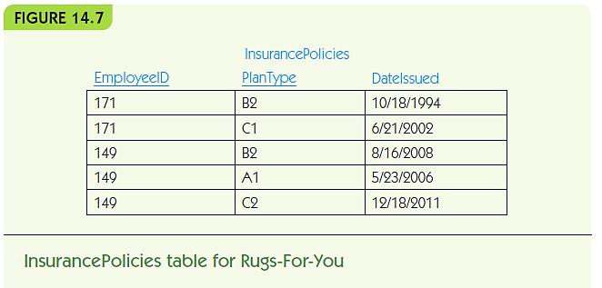
Databases (11 of 15)

Slide 32
Databases (12 of 15)
Multi-table example
SELECT LastName, FirstName, PlanType
FROM Employees, Insurance Policies
Where LastName = ‘Takasano’
AND FirstName = ‘Frederick’
AND ID = EmployeeID;

Slide 33
Databases (13 of 15)
Relational database operations
  Project: pick some attributes from a set of tuples
SELECT LastName, FirstName, PlanType
FROM Employees, Insurance Policies
  Restrict: pick tuples that meet criteria
WHERE LastName = ‘Takasano’
AND FirstName = ‘Frederick’
  Join: combine tuples from different tables
FROM Employees, Insurance Policies
…
AND ID = EmployeeID;

Slide 34
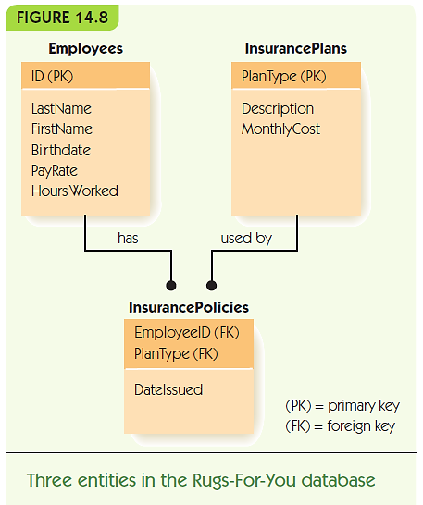
Databases (14 of 15)

Slide 35
Databases (15 of 15)
Database integrity: verification as data is added/removed
  Entity integrity: no primary key can be missing
  Data integrity: values must match category constraints (e.g., be a valid pay rate)
  Referential integrity: foreign keys must match a primary key value in the related table
Efficiency:
  Disk access is slow
  File management systems can organize disk files for faster access
Distributed database: data stored across a computer network

Slide 36
Data Science (1 of 5)
Big data: Huge amounts of available data
Data analysis: Process of finding the right data sets, putting data in the right format, and writing queries to extract information
Data science: Incorporates data analysis tasks, but requires knowledge of the enterprise for useful queries and the use of statistics and visualization techniques to interpret the results and predict future strategies to achieve a predetermined goal
Data warehouse: A collection of databases that contain current and archived data for research and analysis

Slide 37
Data Science (2 of 5)
Data mining: Process of analyzing data to extract and interpret previously hidden patterns through several steps:
  1. Determine the problem to be solved
  2. Review the condition of the data: Does all data have the same structure? Are any tuples missing information?
  3. Determine a model that will help bring out the patterns: Patterns classify the data to determine the strongest predictors of a given outcome – this is the data mining part: creation of a model
  4. Evaluate your model: Are the results predicted borne out by further data? Would a different model give better results?

Slide 38
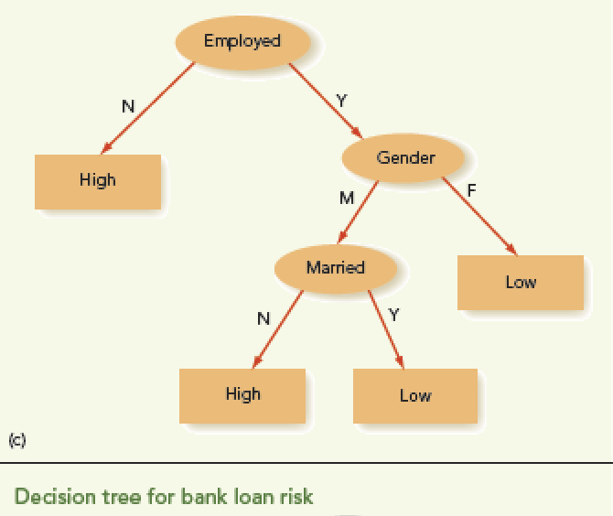
Data Science (3 of 5)
Decision Tree
  One type of model
Easy to convert to an algorithm
  Is the model too simplistic?
  Is the resulting algorithm biased?

Slide 39
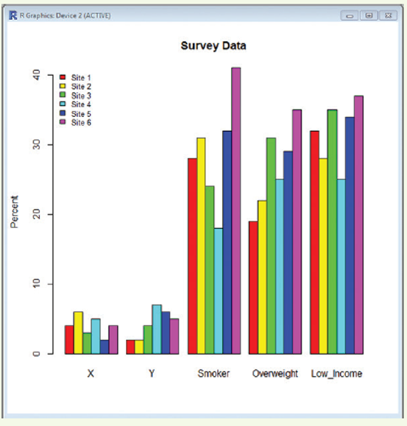
Data Science (4 of 5)
Other Data Science Tools
  Statistical analysis
  Graphical visualization
  Language R can help with both these tasks

Slide 40
Data Science (5 of 5)
Privacy issues associated with data mining
Automatically analyzing large amounts of data to uncover hidden patterns
Data brokers: companies that collect and sell data such as:
  Birth certificates, marriage certificates, publically available information, and nonpublic data purchased or acquired from other companies or data brokers.
Nontheless, data science can make contributions to
  Medicine, science, ecology, and many more fields

Slide 41
Summary (1 of 2)
Ecommerce is a central part of our economy
Businesses deciding to enter the online world must plan carefully
Ecommerce web design is complicated
Ecommerce requires integrating multiple computer systems: inventory, accounting, suppliers, etc.
Databases are systems to store large amounts of data
Data is organized into fields, records, data files, and databases

Slide 42
Summary (2 of 2)
DBMS manages files of databases
The relational database model is the most common: records represent entities; all data is viewed as sets of 2-d tables
SQL is the most common query language for retrieving data from a DBMS
Databases must ensure integrity, efficiency, and (sometimes) distributed access to data
Data mining discovers hidden patterns in a big data set
Privacy issues arise due to data mining techniques

